Slide 1
Multiple Granularity

Slide 2
Multiple Granularity
Granularity: It is the size of data item allowed to lock.
Multiple Granularity:
It can be defined as hierarchically breaking up the database into blocks which can be locked.
The Multiple Granularity protocol enhances concurrency and reduces lock overhead.
It maintains the track of what to lock and how to lock.
It makes easy to decide either to lock a data item or to unlock a data item. This type of hierarchy can be graphically represented as a tree.

Slide 3
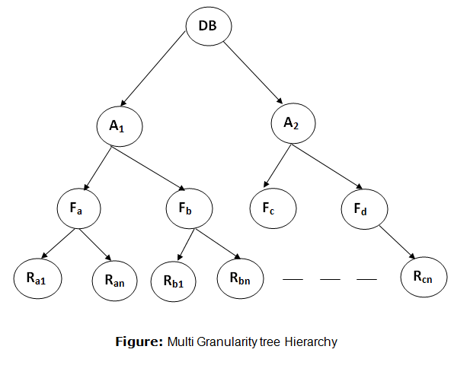
For example:

Slide 4
For example:
Consider a tree which has four levels of nodes.
The first level or higher level shows the entire database.
The second level represents a node of type area. The higher level database consists of exactly these areas.
The area consists of children nodes which are known as files. No file can be present in more than one area.
Finally, each file contains child nodes known as records. The file has exactly those records that are its child nodes. No records represent in more than one file.
Hence, the levels of the tree starting from the top level are as follows:
Database
Area
File
Record
In this example, the highest level shows the entire database. The levels below are file, record, and fields.

Slide 5
There are three additional lock modes with multiple granularity:
Intention Mode Lock
Intention-shared (IS): It contains explicit locking at a lower level of the tree but only with shared locks.
Intention-Exclusive (IX): It contains explicit locking at a lower level with exclusive or shared locks.
Shared & Intention-Exclusive (SIX): In this lock, the node is locked in shared mode, and some node is locked in exclusive mode by the same transaction.

Slide 6


